Slide 1

Coffee
Sales Analysis
- Ishika Patwa

Slide 2
INTRODUCTION :-
PROBLEM STATEMENT :-
Coffee is one of the most popular beverages worldwide, and coffee shops are an essential part of people’s daily routines. To stay competitive, understanding customer preferences and sales trends is crucial. This project “Coffee Sales Analysis” focuses on exploring sales data to identify peak hours, popular weekdays, and spending behavior. The insights aim to help improve marketing strategies, optimize staffing, and enhance overall business performance.
The coffee shop lacks a clear understanding of its sales patterns, customer preferences, and peak business hours. Without data-driven insights, it becomes difficult to optimize staffing, manage inventory, and plan effective marketing strategies. This project aims to analyse sales data to identify key trends and provide actionable recommendations to improve overall business performance.

Slide 3
OVERVIEW :-
Tools Used :-
This project analyzes coffee shop sales data to identify key trends in customer behavior and sales performance.
It explores sales by time of day, weekday patterns, and top-selling coffee products.
The insights aim to help improve marketing strategies, optimize staffing during busy hours, and boost overall business performance.
Python – Main programming language for analysis and visualization.
Pandas – Used for data cleaning, preprocessing, and analysis.
Plotly – Used for creating interactive and visually appealing charts

Slide 4
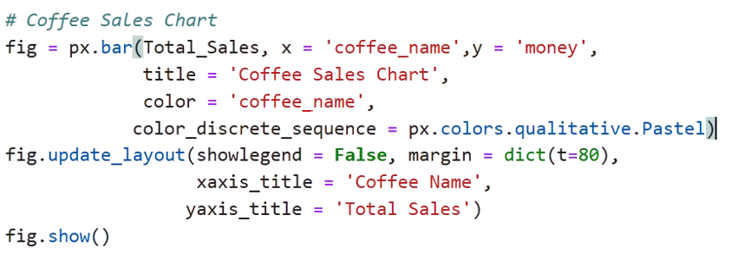
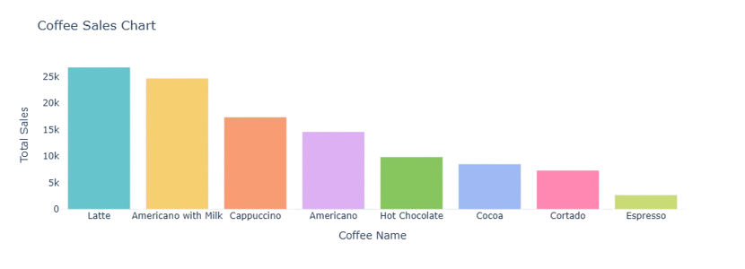
Which Coffee type generate the highest total sales?
Insight:
Latte and Americano with Milk are the top-selling coffees, while Cortado and Espresso have the lowest sales
Recommendation:
Focus on promoting low-selling items and maintaining higher stock for top-performing coffees.

Slide 5
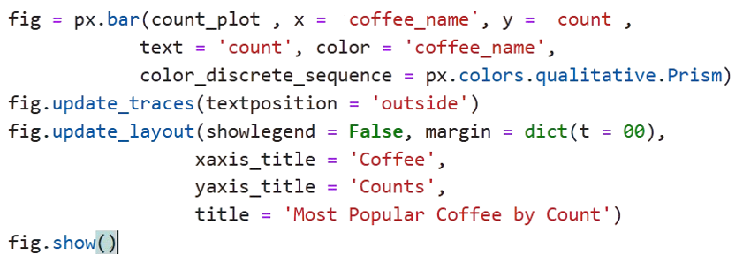
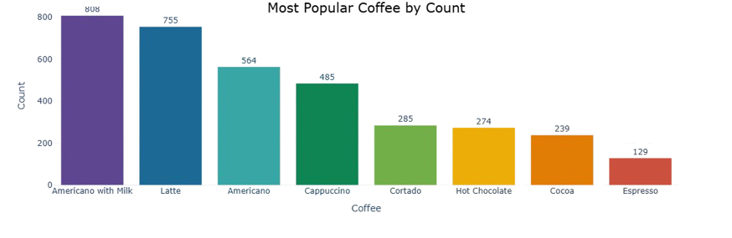
Most Popular Coffee by Count
Insight:
Americano with Milk” leads in sales volume, while Latte drives higher revenue, showing that customers prefer milk-based, medium-strength coffees over stronger or plain options.
Recommendation:
Continue promoting top-selling coffees and consider special offers or tasting campaigns to increase demand for low-selling ones.

Slide 6
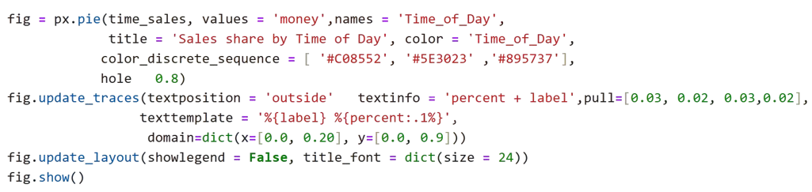

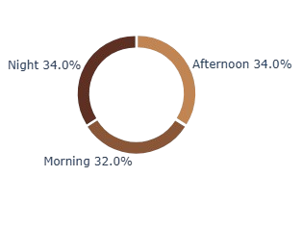
Which time of the day generates the highest total sales?
Insight:
Coffee sales are fairly consistent throughout the day, with slightly higher sales during the afternoon and night compared to the morning.
Recommendation:
Maintain steady staffing and stock across all times, but consider afternoon and night promotions to maximize peak-hour profits.

Slide 7
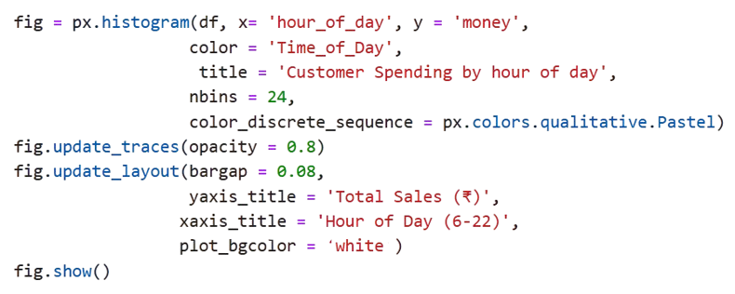
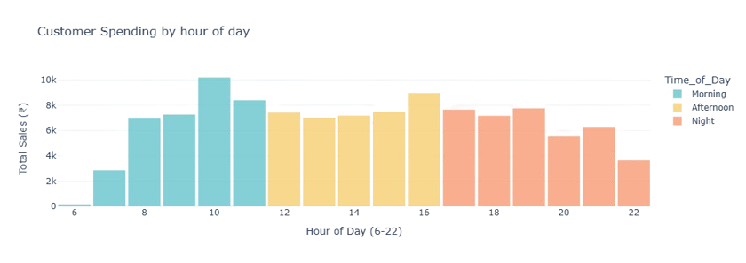
Customer Activity by Time of Day (with Hours inside)
Insight:
Customer spending peaks around mid-morning (around 10 AM) and remains steady through the afternoon, with slightly lower sales at night.
Recommendation:
Introduce special breakfast combos or loyalty discounts for morning customers and promote relaxing evening beverages or dessert pairings to attract more night-time buyers.

Slide 8
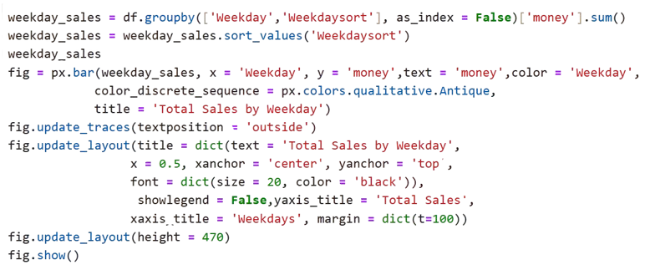
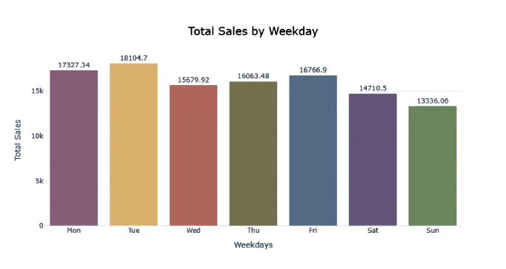
Which days of the week generate the highest coffee sales?
Insight:
Sales are highest on Tuesday and Monday, showing strong weekday demand, while weekends, especially Sunday, see the lowest sales.
Recommendation:
Launch weekend offers or special menu items to attract more customers on Saturdays and Sundays and balance sales throughout the week.

Slide 9
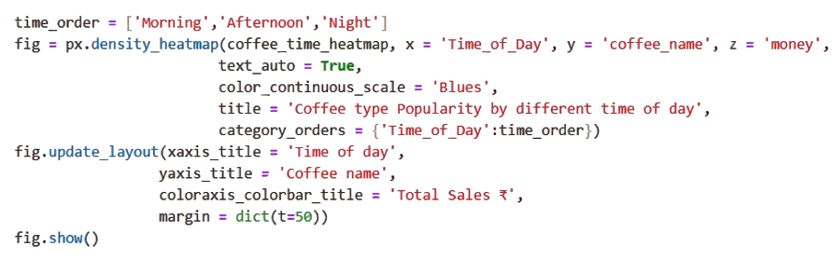
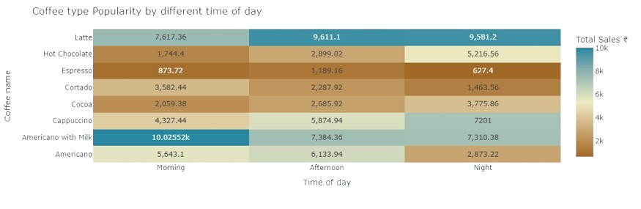
Which coffee types are most popular during different times of the day?
Insight:
Americano with Milk and Latte are the most popular coffee types across all times, especially in the morning and night. Espresso and Cortado have relatively low sales throughout the day.
Recommendation:
Focus on promoting Americano with Milk and Latte during peak hours.
Introduce discounts or combos for Espresso and Cortado to boost their sales.

Slide 10
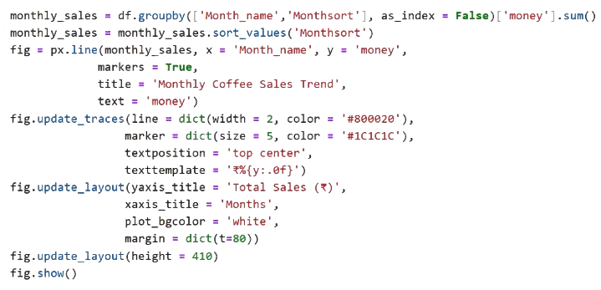
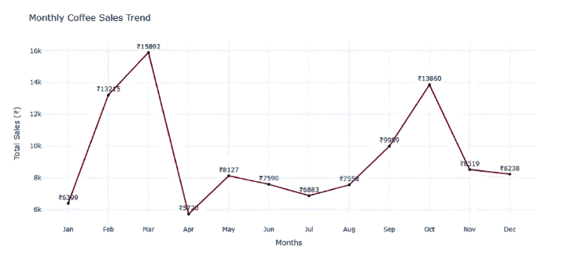
How do total coffee sales change over different months?
Insight:
Coffee sales peaked in March and October, while April to August saw a noticeable dip in performance. This suggests seasonal demand patterns likely influenced by weather or customer behavior.
Recommendation:
Launch targeted promotions or new offers during low-sales months (April–August) to maintain steady revenue. Increase inventory and marketing efforts before March and October to capitalize on high-demand periods.

Slide 11
INSIGHTS :-
Afternoon and night hours show higher coffee sales compared to mornings.
Weekday sales peak on Tuesdays, with Sunday showing the lowest performance.
Americano with Milk and Latte are the most popular coffee types across all time periods.
Monthly trends show strong sales in March and October, indicating seasonal demand peaks.
Certain coffee types like Cocoa and Hot Chocolate perform better during night hours.

Slide 12
RECOMMENDATION:-
Introduce targeted promotions or discounts during morning hours to boost early-day sales.
Maintain higher staff levels and inventory on high-demand days like Tuesdays.
Highlight and promote top-sellers like Americano with Milk and Latte to attract more customers.
Launch seasonal campaigns or limited-time offers during March and October to capitalize on peak demand.
Enhance late-hour sales by promoting Hot Chocolate and introducing combo offers or discounts for low-performing drinks like Espresso.

Slide 13
CONCLUSION:-
The Coffee Sales Analysis provided valuable insights into customer preferences, peak sales periods, and top-performing products. The findings reveal strong demand during afternoon and night hours, with Latte and Americano with Milk leading in popularity. By applying data-driven strategies such as optimizing inventory, staffing, and targeted promotions the coffee shop can enhance sales efficiency, improve customer satisfaction, and drive overall business growth.

Slide 14

Thank
You…!

